Slide 1
HEALTHY WOMEN, STRONG UNION; POSITIONING SSANU WOMEN FOR LEADERSHIP AND NATIONAL RELEVANCE
A KEYNOTE ADDRESS DELIVERED BY DR. ASABE VILITA BASHIR AT THE 2026 SSANU NATIONAL ANNUAL WOMEN’S CONFERENCE HELD ON TUESDAY 27TH OCTOBER, AT THE NATIONAL UNIVERSITIES COMMISSION, MAITAMA, ABUJA.

Slide 2
OPENING REMARKS
PROTOCOL
00
I am indeed delighted to join you at this very important and timely conference, which addresses a critical issue: the well-being, leadership, and national relevance of women in the labour movement.
I commend Senior Staff Association of Nigerian Universities(SSANU ) for choosing the theme “Healthy Women, Strong Union: Positioning SSANU Women for Leadership and National Relevance.” Therefore, the theme goes beyond a conference's discussion. The theme is a call for social change, reorientation, and transformation on how women's health is prioritized, how women's contributions are valued, and how women's leadership potential is realized.
My address will focus on 6(six) interconnected pillars: (1)women's well-being, (2)union strength, (3)leadership development
(4) NATIONAL INFLUENCE.
(5)A PRACTICAL AGENDA FOR SSANU
(6)THE CHARGE
Dr. Asabe Vilita Bashir
Keynote Address · NUC Abuja

Slide 3
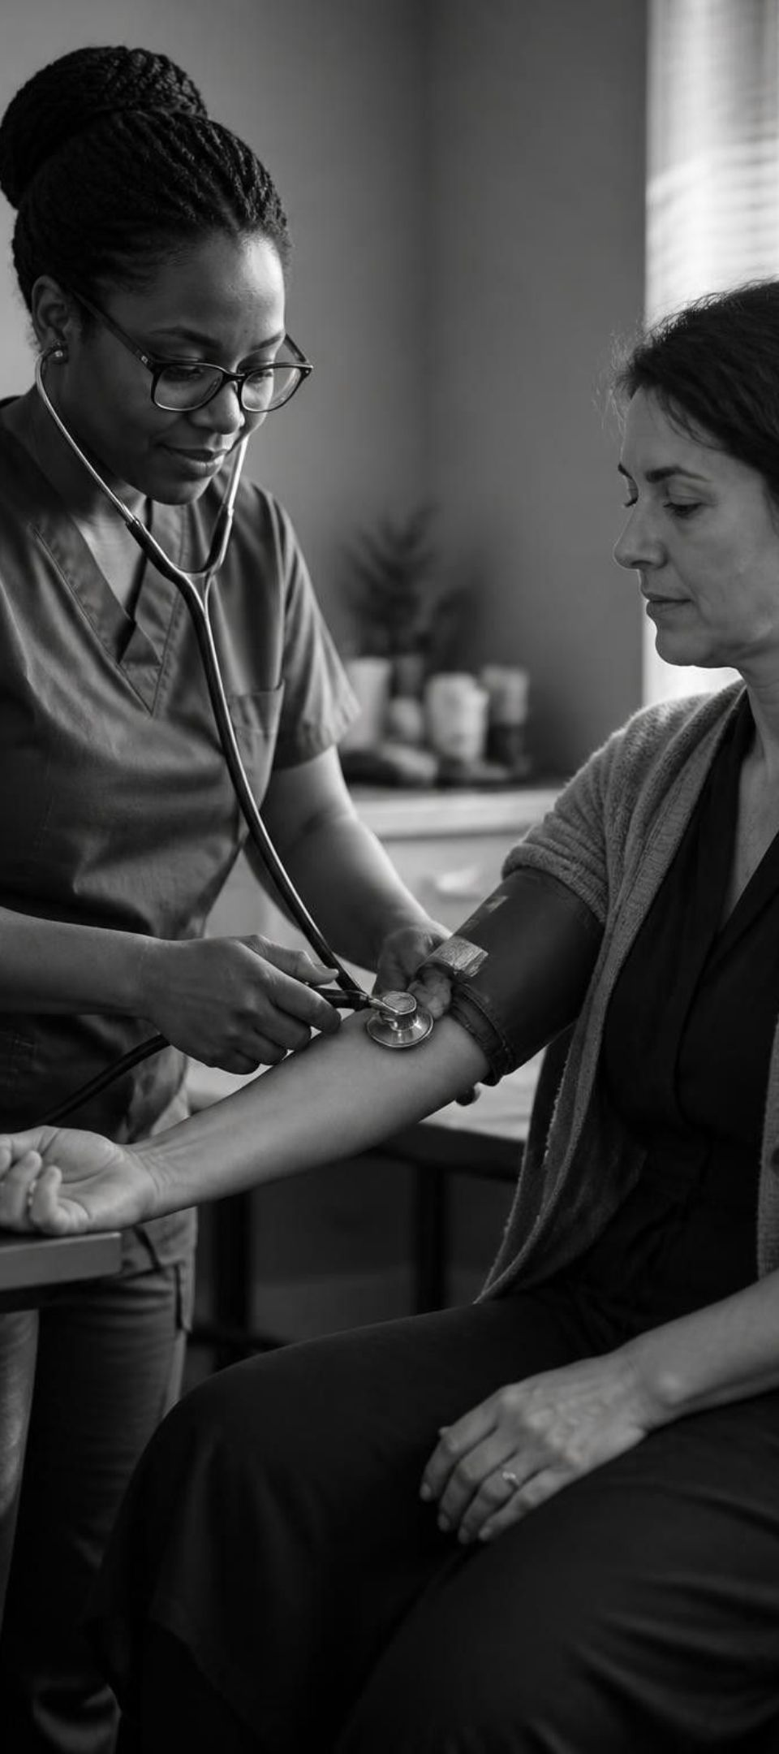
PILLAR 1. A HEALTHY WOMAN IS THE FOUNDATION
Distinguished Guests, Ladies and Gentlemen, you will all agree with me that a healthy woman is an asset to her family, workplace, union, organization and the nation at large. Women's health, however, extends beyond physical fitness to include mental, emotional, and financial wellbeing.
It is also a known fact that Women across all sectors of the economy especially in universities often balance professional responsibilities with family and caregiving demands. In doing so, many neglect their own needs.
We must theregore change this culture.
Women need access to preventive healthcare, regular medical check-ups, proper nutrition, physical activity, and adequate rest. Women are also expected to receive attention, with supportive environments that allow her to seek help without been stigmatized.
It is also important to state that the financial wellbeing of our women should not be neglected while also noting that financial literacy, savings, investment knowledge, and economic independence strengthen women's confidence and ability to make informed decisions.
SSANU should therefore integrate wellness initiatives, health education, stress management, and financial literacy into its programmes. This is because a strong union must recognize that women’s health is not a private concern alone but an essential component of staff welfare and organizational effectiveness.
On the other hand, I wish to advise women to take good care of themselves because it is only a woman who prioritizes her wellbeing that is better equipped to serve, contribute and lead.

Slide 4
PILLAR 2. A STRONG UNION REQUIRES ACTIVE WOMEN'S PARTICIPATIO:
02
PILLAR TWO
The strength of a union lies in its unity, commitment, and ability to represent the interests of all its members.
Women contribute valuable skills in organization, negotiation, conflict resolution, and relationship management. Their participation strengthens collective bargaining, staff welfare, and institutional development.
Despite these valuable skills, women are most times relegated to mobilization and administrative support thereby denied access to strategic decision-making positions.
Please SSANU, try and change this imbalance.
SSANU women must move beyond supporting union activities to influencing policies, participating in negotiations and occupying leadership positions where they will contribute to the growth of the union and national development.
I encourage SSANU to create more opportunities for women to serve on committees, participate in negotiations and contest leadership positions.
Women, in turn, must support one another, share opportunities, and build networks that promote collective advancement.
Let me also warn here that this is not about competing with men;it is about ensuring that leadership reflects the abilities and contributions of the entire membership(,i e both men and women).
Unity among women means creating opportunities for one another to grow, succeed and lead.
From supporting union activities to shaping policies and negotiations.
A strong union is one where women are not merely present but actively involved in shaping decisions and determining the organization’s future.

Slide 5

03
PILLAR 3. POSITIONING WOMEN FOR LEADERSHIP
PILLAR THREE
Fellow Comrades, Leadership requires preparation, competence, confidence, and courage. Women must deliberately develop the skills and visibility needed to assume greater responsibilities.
I therefore encourage SSANU women to focus on four priorities:
PRIORITY 1
PRIORITY 2
First, build your capacity.
Develop skills in public speaking, negotiation, strategic planning, conflict management, policy analysis, and digital technology. These competencies are essential for effective union administration and leadership in today's changing workplace.
Second:make your contributions visible.
Participate actively in meetings, present proposals, volunteer for strategic assignments, document, and communicate your achievements. Competence is important, but women must also ensure that their contributions are recognized.
PRIORITY 3
PRIORITY 4
Thirdly:embrace mentorship and networking.
Experienced women leaders should guide emerging professionals, share knowledge, create opportunities for others, while aspiring leaders must also seek guidance, learn continuously, and prepare for greater responsibilities.
Fourthly: challenge cultural and institutional barriers.
Traditional expectations and gender stereotypes can limit women's leadership opportunities. We must address these barriers through advocacy, fair institutional practices, and demonstrable competence.
Preparation, competence, confidence, and courage.
Women must also overcome self-doubt and the fear of taking on new responsibilities.
Do not wait for leadership opportunities to find you. Prepare for them, seek them, and demonstrate your capacity to lead.So, the objective is not simply to occupy positions but to lead effectively, deliver results and leave lasting legacies.

Slide 6
PILLAR 4. NATIONAL RELEVANCE: TAKING WOMEN'S LEADERSHIP BEYOND THE CAMPUS:
SSANU women have the potential to influence national development beyond their respective universities.
Their professional experience and understanding of workplace issues them oppprtunities to contribute to national conversations on labour related issues , education, gender equality, economic empowerment, and public policy.
However, national relevance requires more than participation in conferences. It demands informed advocacy, strategic partnerships, and sustained engagement with decision-makers.
SSANU women can collaborate with government institutions, professional associations, civil society organizations, and development partners to promote policies that advance women's welfare and leadership.
The association could establish a Women’s Leadership and Policy Advocacy Platform to develop emerging leaders, document challenges facing women in the university system and present evidence-based recommendations to relevant authorities.
A structured mentorship network could also connect experienced leaders with younger professionals preparing for leadership roles.
Through these initiatives, SSANU women can expand their influence, strengthen professional networks and contribute to national policy development.
Your voices must be heard where decisions are made, and your expertise must help shape policies that affect women, workers and the nation at large .
National relevance begins when we move from identifying challenges to proposing solutions and influencing change.

Slide 7
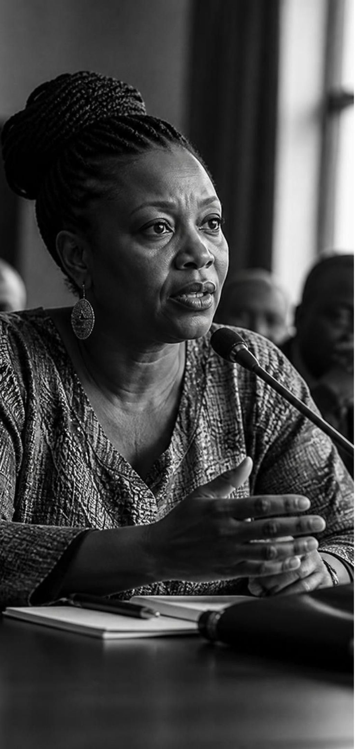
PILLAR 5. A PRACTICAL AGENDA FOR SSANU:
To translate this theme into measurable progress, I wish to propose five actions:
To promote women's wellness by integrating physical and mental health awareness, preventive healthcare, and financial literacy into union programmes.
To strengthen leadership development by providing regular training in negotiation, communication, digital skills, and strategic management.
To institutionalize mentorship by connecting experienced women leaders with emerging professionals and aspiring union executives.
To promote inclusive representation by creating more opportunities for women to participate in decision-making, negotiations, and executive leadership.
To expand advocacy and partnerships through engaging relevant institutions and organizations to advance women's welfare, leadership, and policy influence.
These actions should have clear targets, timelines, and mechanisms for monitoring progress.
Distinguished Ladies and Gentlemen, the success of this conference will not be measured by the quality of our discussions alone, but by the changes, we achieve afterwards.

Slide 8
PILLAR 6. THE CHARGE:
As I conclude, permit me to leave SSANU women with these clear messages:
Be Healthy. Prioritize your physical, mental, emotional, and financial well-being.
Be Skilled. Invest in continuous learning and develop the competencies required for leadership.
Be United. Support one another, share opportunities, and pursue common goals.
Be Visible. Participate actively, express your ideas, and demonstrate the value you bring.
Be Ready to Lead. Prepare for responsibility, seek opportunities, and lead with competence, integrity and confidence.
I encourage every participant to identify one practical action to take after this conference—whether improving personal wellbeing, acquiring a new skill, mentoring an aspiring leader or advocating for greater women's representation.
Imagine the impact if every woman here commits to helping another woman to advance. Such deliberate actions, multiplied across SSANU's structures, can transform the union's leadership landscape.
Let us remember that leadership is not defined by titles alone. It is reflected in the decisions we make, the people we empower and the institutions we strengthen.

Slide 9
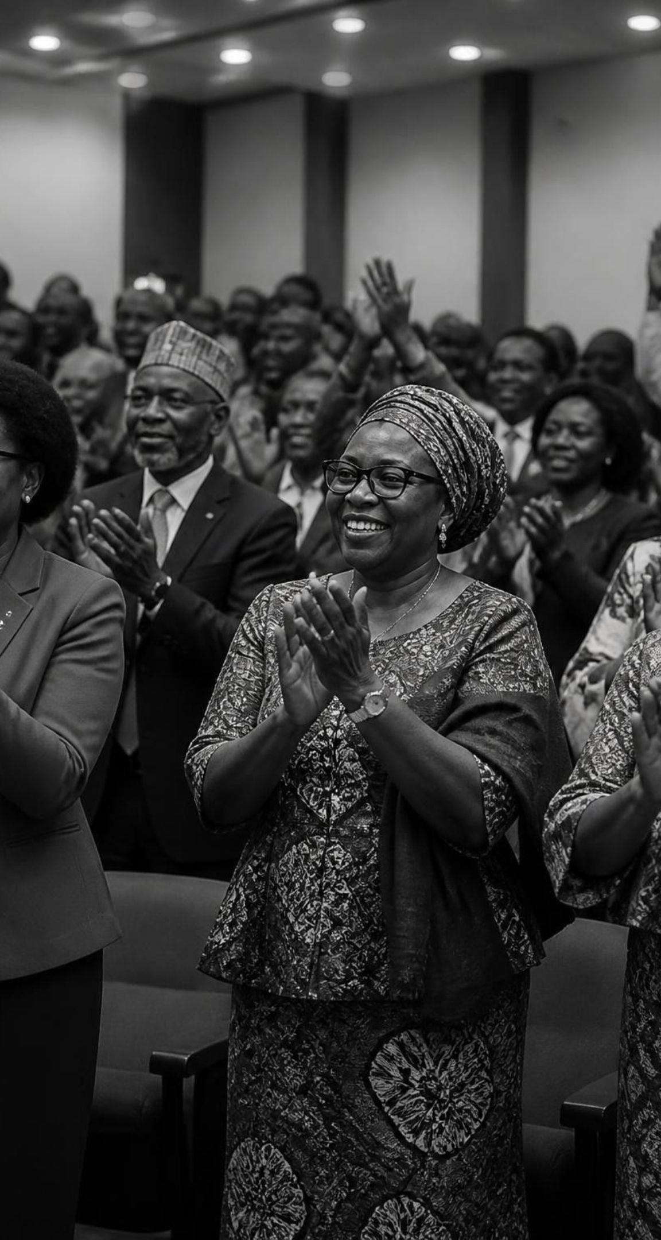
IN CONCLUSION,
Distinguished ladies and gentlemen, the message of this conference is clear: healthy women strengthen unions, prepared women advance leadership, and influential women contribute to national development.
We cannot build a strong union while neglecting women's well-being. We cannot achieve inclusive leadership without capacity building and equal opportunities. Neither can we attain national relevance without engaging beyond our immediate professional environment.
Let this conference mark a shift from participation to influence, from support roles to strategic leadership, and from individual advancement to collective impact.
To the women of SSANU, I say: your well-being matters, your contributions count, and your leadership is needed.
Let us build a union where women participate meaningfully, influence decisions, and lead with distinction. Let us also position SSANU women as credible voices in national affairs and partners in Nigeria's development.
Be Healthy. Be Skilled. Be United. Be Visible. Be Ready to Lead.
I wish you fruitful deliberations and a successful 2026 SSANU National Annual Women's Conference.
Thank you.
God bless SSANU. God bless the women of Nigeria. God bless the Federal Republic of Nigeria.

